Slide 1


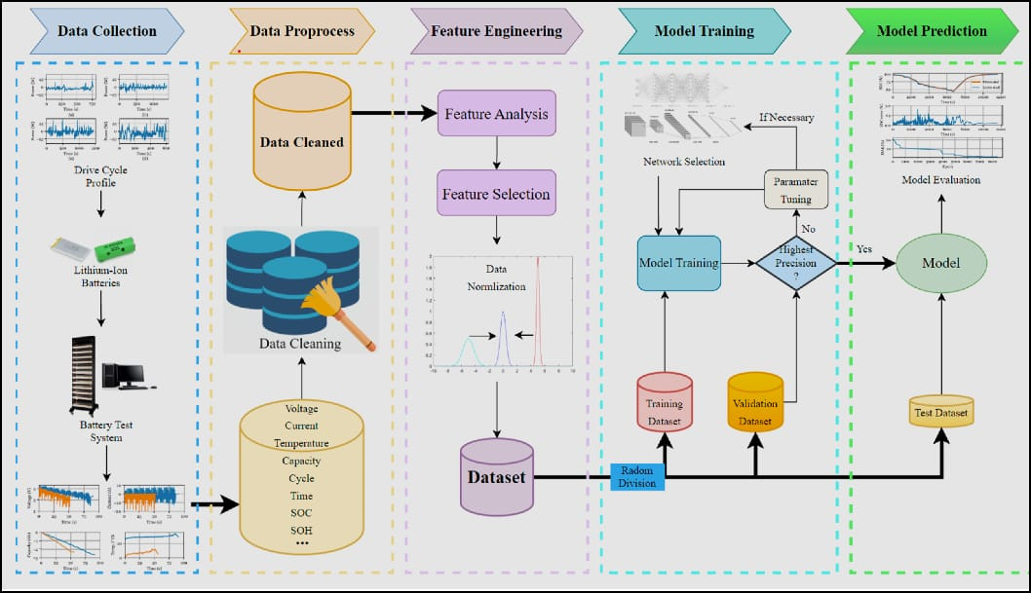
Battery Data Analysis & Feature Engineering Insights
NAME:- SREEJA SANYAL
WEEK :-2
DAY:-14
DATE:- 09.09.2026

Slide 2


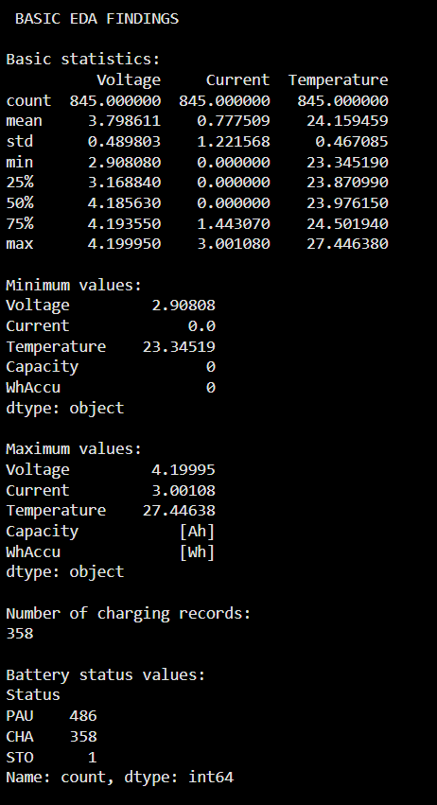
EDA FINDINGS
What did the data tell us?
Voltage, Current & Temperature → Key battery measurement variables
Power → derived electrical feature
Time → Charging progression
SOC → Primary prediction target
EDA revealed nonlinear relationships among several battery variables.
Data quality & leakage checks are important before model training.
1.
2.
3.
4.
5.
6.
EDA was used to understand the distribution, trends, and relationships present in the battery data.
1.

Slide 3
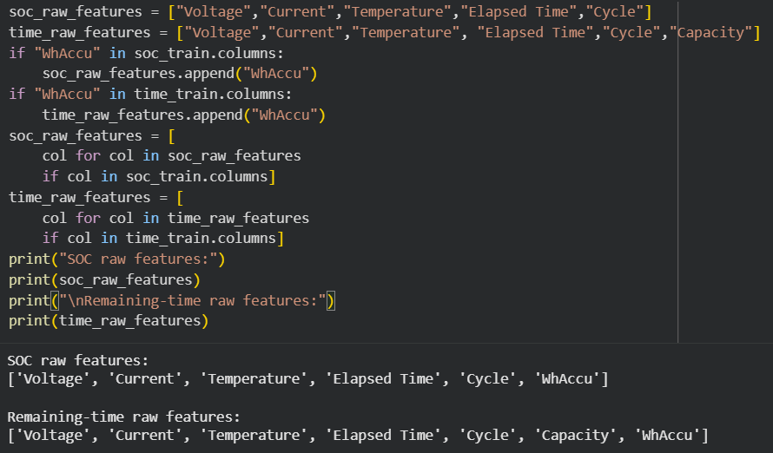
FEATURE ENGINEERING
Features Considered | FeaturePurpose
Voltage | Electrical measurement
Current | Charging measurement
Temperature | Thermal measurement
Power | Derived electrical feature(voltage *current)
SOC | Target/battery state variable
Relevant electrical and time-based features were derived to support SOC and charging-time prediction.
2.

Slide 4
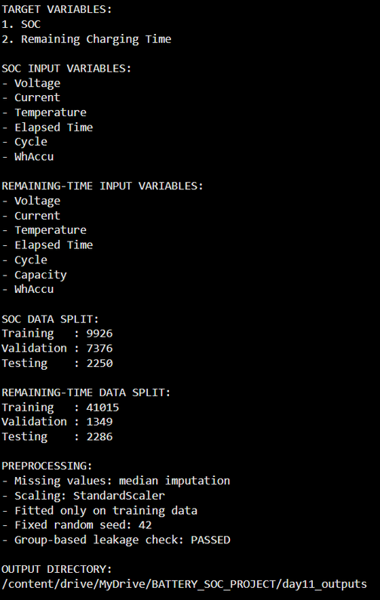
DATA PREPARATION FOR MODELING
Component | Selected Variable
Input Features (X) | Voltage, Current, Temperature, Power
Target (y) | Remaining Charging Time
Data Split | Training Set + Test Set
Purpose | Prepare the dataset for the upcoming regression stag
The target variables and selected input features were summarized before model development.
3.

Slide 5
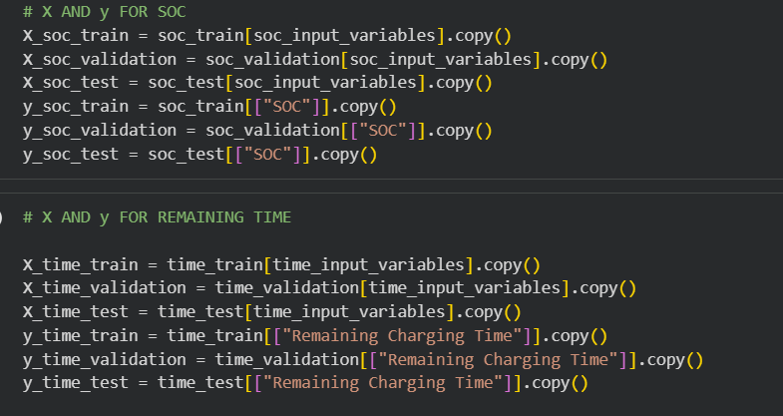
Prediction Setup
Input Features (X)
(Voltage + Current + Temperature + Power )
↓
Regression Model
↓
Target (y)
Remaining Charging Time
The selected charging-related variables are used as input features.
Remaining Charging Time is defined as the prediction target.
This creates the basic input–target structure required for regression.
The prepared setup will be used in the upcoming modeling stage.
Separate input features (X) and target variables (y) were defined for SOC estimation and Remaining Charging Time prediction.
4.

Slide 6
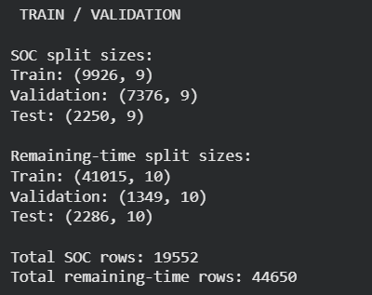
Train–Test Split
Why was the dataset split?
Training set → Used for learning patterns from the available data.
Test set → Used to evaluate the model on data not used during training.
Separating the two sets helps prevent evaluating the model on the same observations it learned from.
The test set provides a more realistic indication of how the model may perform on unseen data.
This separation is an important step before developing the regression models.
The dataset was divided into training, validation, and testing sets for reliable model evaluation.”
5.

Slide 7
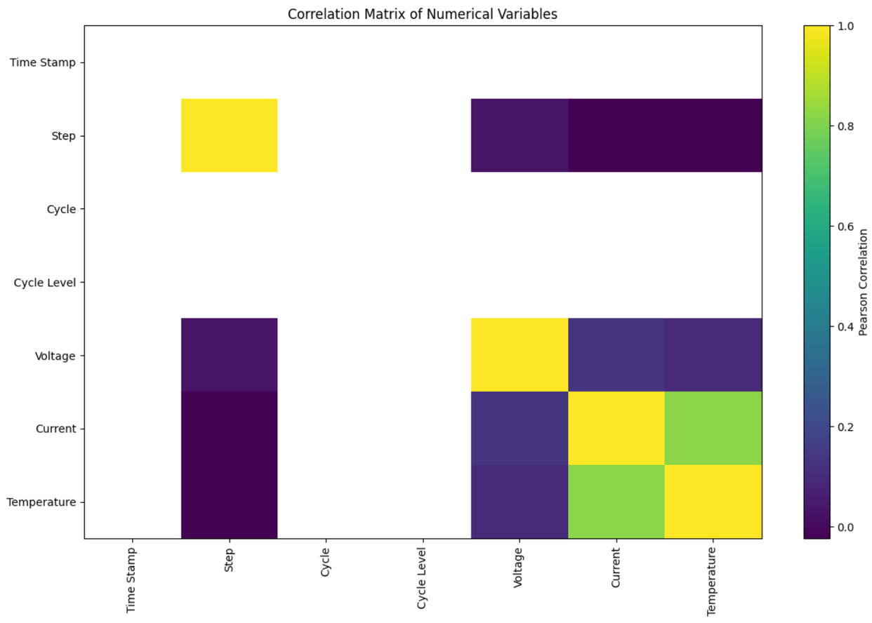
Correlation Analysis
What was checked?
Examined relationships between the numerical variables in the dataset.
Checked how the selected input features are related to each other.
Examined the relationship between the predictors and the prediction target.
Correlation helps identify the strength and direction of linear relationships.
The analysis provides an initial understanding of variable dependencies before regression modeling.
Correlation was treated as an exploratory analysis rather than proof of causation.
Correlation analysis was performed to examine relationships between the selected features and target variables.
6.

Slide 8
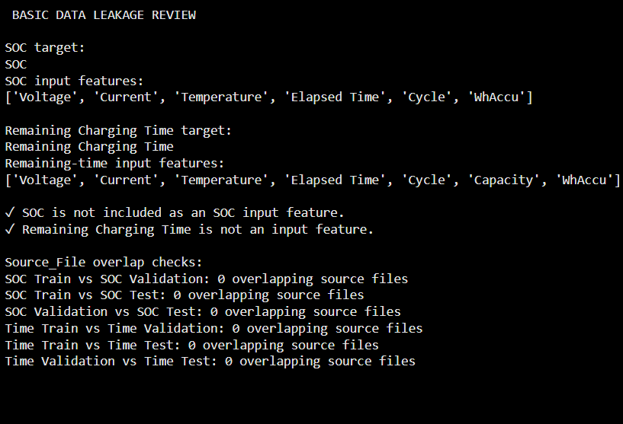
Data Leakage Check
Why was leakage checked?
Checked whether information related to the target could unintentionally appear among the input variables.
Data leakage can make a model appear more accurate than it actually is.
A proper modeling setup should ensure that the model receives only appropriate predictor information.
The check helps maintain a fair separation between input features and the prediction target.
This improves the reliability of the evaluation in the upcoming modeling stage.
The selected features were checked to ensure that target information was not unintentionally included.
8.

Slide 9
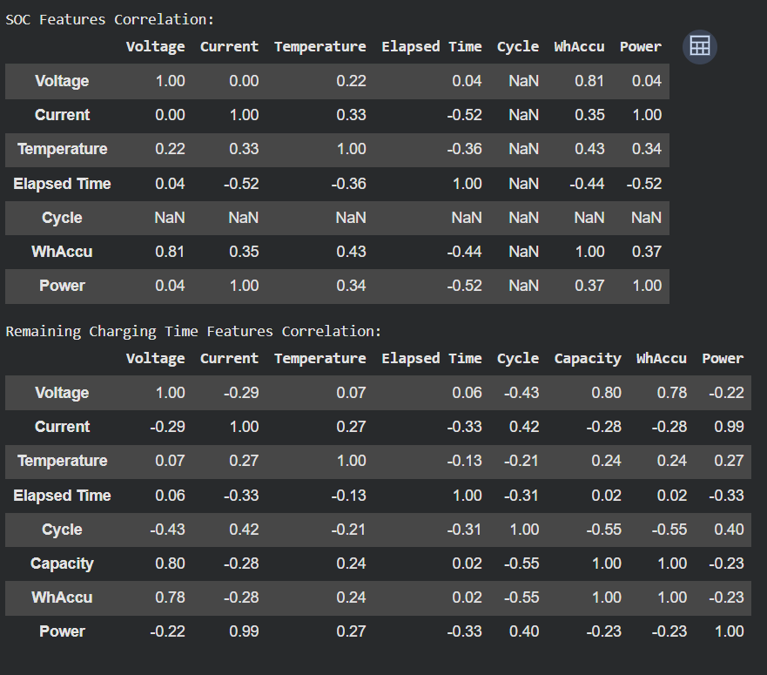
Multicollinearity Check
Correlation-Based Check
Examined the correlation between selected input features.
Separate correlation matrices were generated for the SOC feature set and Remaining Charging Time feature set.
Power was included along with the respective raw features.
The correlation values were rounded for easier interpretation.
This check helps identify features that may have strong relationships with each other.
It provides an initial indication of possible multicollinearity before regression modeling.
Feature-to-feature correlations were examined to identify potential multicollinearity among modelling inputs.
7.

Slide 10
Data Pipeline
Data Quality Assessment — fits your missing-value/data-quality work.
Feature Engineering — makes the pipeline clearer than only saying feature selection.
File Organization — useful because you created organized outputs/reports during the project.
Raw Data
↓
Data Reading
↓
Cleaning & Preprocessing
↓
EDA & Data Understanding
↓
Feature Engineering / Feature Selection
↓
Target Definition
↓
Train–Validation–Test Preparation
↓
Correlation Analysis
↓
Multicollinearity Check
↓
Data Leakage Check
↓
Modeling-Ready Dataset
9.

Slide 11
Conclusion
1.
Dataset was cleaned, explored, and analysed through EDA.
2.
Relevant features and Remaining Charging Time as the target were identified.
3.
Train–test split and basic correlation, multicollinearity, and leakage checks were completed
4.
Dataset is now ready for regression model development in the next stage.
Thank You!
10.

